Slide 1

Solar Power Plant design
Lecture-13 : Plant Capacity calculation (off-Gird)

Slide 2
Off grid Solar power plant (plant capacity Calculation)
Sl No No | Equipment’s Name | Load (Watt) | Quantity | Operating Hours | Load Schedule |  | Total watt-hours
1 | Tube light | 40 | 10 | 12 | - | 12 | - | 4800
2 | Fan | 40 | 10 | 24 | 12 | 12 | 4800 | 4800
3 | CFL | 16 | 20 | 12 | - | 12 | - | 4800
4 | Geasor | 1500 | 2 | 2 | 2 | - | 6000 | -
5 | Computer | 100 | 10 | 12 | 12 | - | 12000 | -
6 | Outdoor light | 16 | 20 | 12 | - | 12 | - | 3840
7 | Pump | 746 | 1 | 2 | 2 | - | 1492 | -
Total Load (Night & Day time ) |  |  |  |  |  |  | 24292 | 17280

Slide 3
Total Day time consumption = 24292 watt hour = 24.292 KWH
Total Night time consumption = 17280 watt hour: 17.280 KWH
Total Consumption = Day time consumption + Night time consumption
= 24.292 + 17.280
= 41.572 KWH
= 42 KWH

Slide 4
**For Night time consumption, we need to consider battery backup.
Calculation of Solar Power plant according to MNRE:
Total Consumption = 42 KWH
Plant peak sunny hour operation 5.6 to 5.8 hours (Normal consideration)
Plant Performance = 70% = 0.7
Solar Power plant capacity = Total consumption
PSH X Plant Performance
= 42000
5.6 x 0.7
= 10714.28 w
= 10.714 KW
= 11 KW (Plant capacity to be installed)
**1 KW plant generally gives 3.8 to 4 unit generations
By thumb rule, this plant (11 KW) will give 44 units generation.

Slide 5
Plant Performance = 70% = 0.7
Solar Power plant capacity = Total consumption
PSH X Plant Performance
= 42000
5.6 x 0.7
= 10714.28 w
= 10.714 KW
= 11 KW (Plant capacity to be installed)
**1KW plant generally gives 3.8 to 4 unit generations
By thumb rule, this plant (11 KW) will give 44 units generation.
OR 42 KWH/4 = 10.5 KW = 11KW
Plant Capacity = 11KW
No of PCU = 1 no X 15 KW
Module Rating = 250 Wp
Total no of modules required = 15 X 1000
250
= 60 no's

Slide 6
Battery Sizing Calculation:
Battery will be required for night time only.
Hence, Night consumption 17.280 KWH
Day of Autonomy = 1day (Means how many days it will carry the charge)
Margin is 15 % extra i.e. (100% + 15% ) = 115% = 1.15
Battery unit is in AH.

Slide 7
PCU Charge controller Voltage
0.5 KW to 2 KW = 12 V
2 KW to 10 KW = 24 V
10 KW to 20 KW = 48 V
20 KW t0 50 KW = 96 V
50 KW t0 60 KW = 110 V
60 KW to 100 KW = 220 V
Depth of Discharge (DOD) = Assume depth of discharge as 80 % = 0.8
I.e. Battery will not discharge below 20% of battery voltage.
Battery Efficiency = 90 % = 0.9

Slide 8
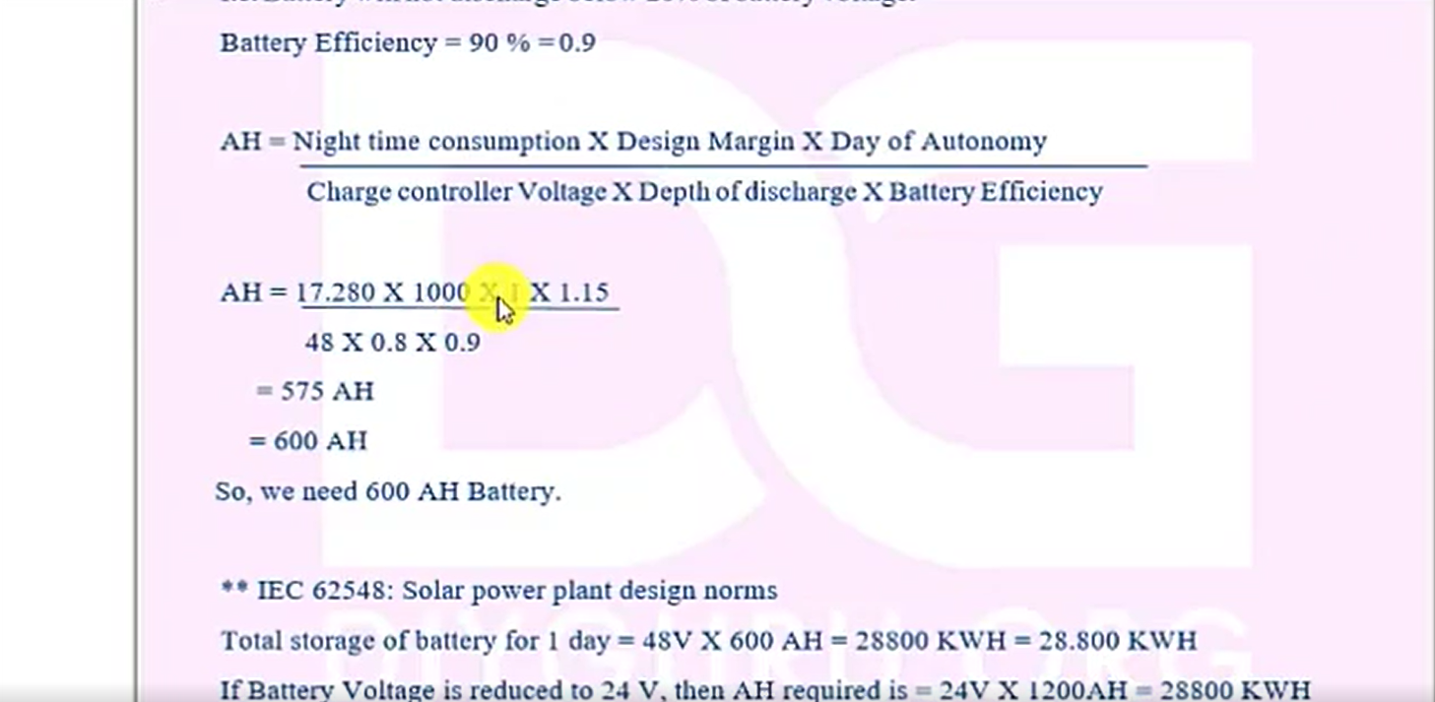

Slide 9
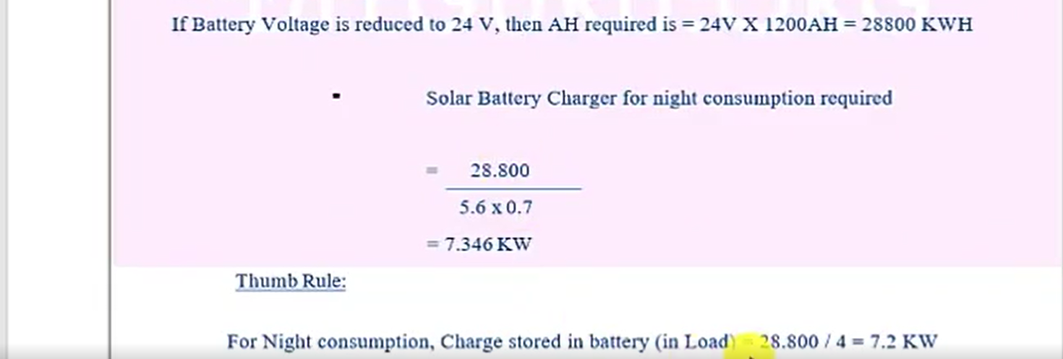

Slide 10
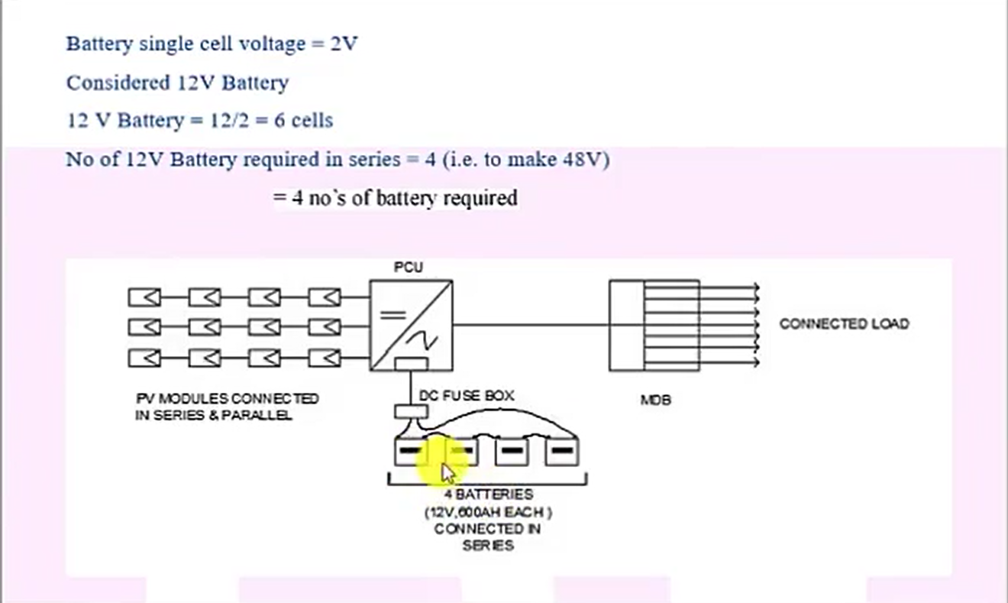

Slide 11
Thank You

